Slide 1

Unit 3: Lesson 4 We run for fun

Slide 2
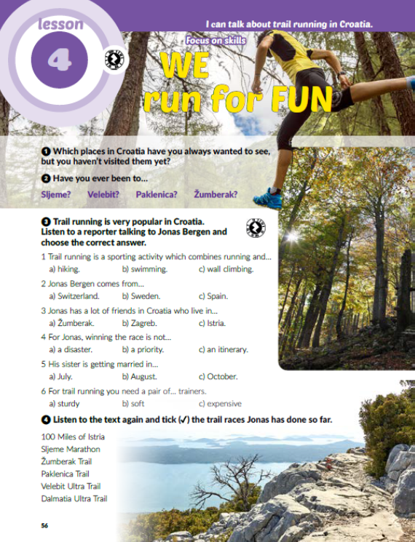
Task 1: Which places in Croatia have you always wanted to see, but you haven’t visited them yet?
Task 2: Have you ever been to Sljeme, Žumberak, Paklenica or Velebit?

Slide 3

Task 3: Listen to a reporter talking to Jonas Bergen and choose the correct answer.
https://www.e-sfera.hr/dodatni-digitalni-sadrzaji/1c3b89a2-aef8-4b6a-8e9b-df4631a24e35/

Slide 4


Task 4: Listen to the text again and tick the trail races Jonas has done so far.
https://www.e-sfera.hr/dodatni-digitalni-sadrzaji/1c3b89a2-aef8-4b6a-8e9b-df4631a24e35/

Slide 5
Task 5: Listen to the text again and complete the sentences.
https://www.e-sfera.hr/dodatni-digitalni-sadrzaji/1c3b89a2-aef8-4b6a-8e9b-df4631a24e35/
longer
sleep
immune
improve
knees
diabetes
fun
equipment

Slide 6
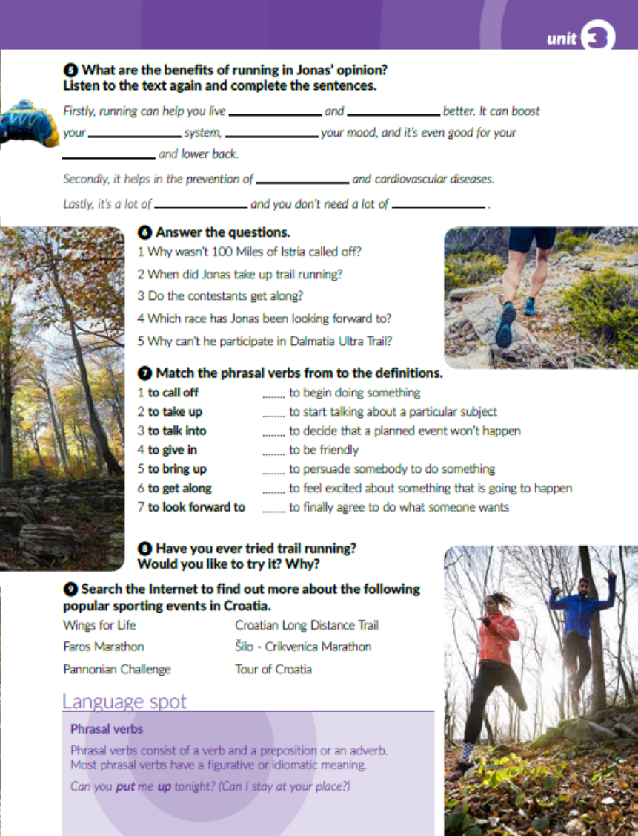
Task 6: Answer the questions.
Zašto je otkazana utrka pod nazivom 100 Miles of Istria?
Kada se Jonas počeo baviti trčanjem?
Kako se natjecatelji slažu međusobno?
Kojoj se utrci Jonas veselio?
Zašto ne može sudjelovati na Dalmatia Ultra Trail?

Slide 7

Task 7: Match the phrasal verbs to the definitions.
2
5
1
6
3
7
4
Frazalni ili frazni glagol se sastoje od glagola i prijedloga ili priloga. Većina frazalnih glagola ima metaforičko značenje tako da se ne mogu doslovno prevoditi.

Slide 8

Task 8: Have you ever tried trail running? Would you like to try it? Why?
Task 9: Search the Internet and find out more about popular sporting events listed in task 9.

Slide 9
workbook, page 58
Task 1: Label the trail races on the map of Croatia..
Žumberak Trail
Velebit Ultra Trail
100 Miles of Istria
Paklenica Trail
Dalmatia Ultra Trail

Slide 10
Task 2: Match the words/expressions to the definitions.
3
6
2
9
7
4
8
5

Slide 11
Task 3: Complete the sentences with the phrasal verbs from the box. Make the necessary changes.
call off
bring up
give in
look forward to
get along
talked into

Slide 12
Task 4: Use the present perfect simple to describe what Anika has already done and what she hasn’t done yet.
Anika has already chosen a caterer. She hasn’t hired a photographer yet. She has already bought a wedding dress. She hasn’t sent invitations yet. She has already organized a tasting with a caterer. She already registered for gifts. She hasn’t booked the honeymoon yet. She has already rented bridesmaids’ dresses. She has already planned the menu. She hasn’t written the vows yet. She has already given the song selection to the DJ. She hasn’t created the seating chart yet.

Slide 13

PLAY AND LEARN!
https://www.e-sfera.hr/dodatni-digitalni-sadrzaji/1c3b89a2-aef8-4b6a-8e9b-df4631a24e35/

